Slide 1
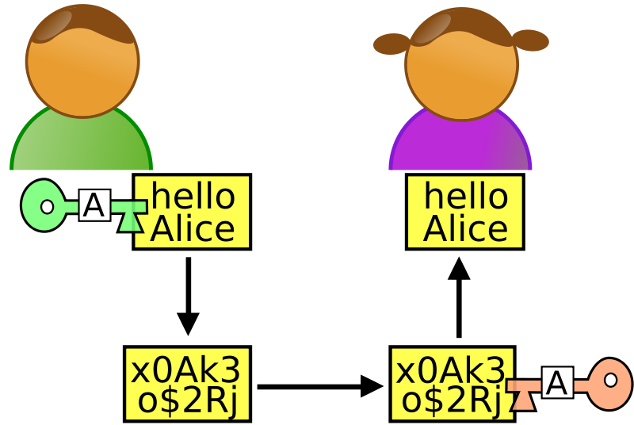
CRYPTOGRAPHY

Slide 2
SECURITY GOALS
CONFIDENTIALITY INTEGRITY
SECURE
NON-REPUDIATION

Slide 3
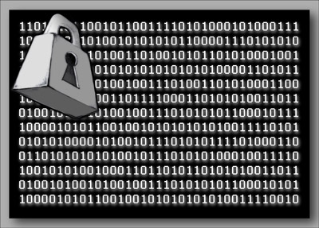
CRYPTOGRAPHY
Cryptography is a method of storing and transmitting data in a form that only can read and process by those it is intended.
Cryptography is the science and art of transforming messages to make them secure and immune to attack.

Slide 4

ENCRYPATION & DECRYPTION

Slide 5
BASIC TERMS
Plain text: Data in a readable format, also referred to as clear text.
Encryption: Encryption is a method of transforming original data or plain text, into unreadable form of data.
Decryption: Decryption is a method of transforming unreadable form of data or Cipher text, into readable form of data (Plain text).
Cipher text: Data in encrypted or unreadable format is called “Cipher text”.

Slide 6
BASIC TERMS
Encipher: Act of transforming data into unreadable format.
Decipher: Act of transforming data into readable format.
Key: Secret sequence of bits and instruction that governs the act of encryption and Decryption.
Algorithm: An Algorithm is a set of mathematical rules used in encryption and decryption.

Slide 7
BASIC TERMS
Cryptanalysis: Practice of obtaining Plain text from cipher text without a key or breaking the encryption.
Cryptosystem: Hardware or Software implementation of cryptology that transforms a message into cipher text and back in to Plain text.
Cryptology: The study of both Cryptography and Cryptanalysis.

Slide 8
Types of Cipher Text
Block Type Cipher Text:
Block type cipher text is a cipher text, in which a block of message is encrypted at a time.
Stream Type Cipher Text:
Stream type cipher text is a cipher text, in which every bit is encrypted at a time.
Stream type is more secure than block type.

Slide 9
CATEGORIES OF CRYPTOGRAPHY
ASYMMETRIC KEY CRYPTOGRAPHY
SYMMETRIC KEY CRYPTOGRAPHY

Slide 10
SYMMETRIC KEY CRYPTOGRAPHY
An encryption system in which the sender and receiver of a message share a single, common key that is used to encrypt and decrypt the message.
Symmetric-key cryptography is sometimes called secret-key cryptography. The most popular symmetric-key system is the Data Encryption Standard (DES).

Slide 11

SYMMETRIC KEY CRYPTOGRAPHY
SENDER
RECEIVER
SECRET KEY
ENCRYPTION
DECRYPTION
CIPHERTEXT

Slide 12
ASYMMETRIC KEY CRYPTOGRAPHY
In asymmetric cryptography (also known as public-key cryptography) we use a different key on each side to decrypt and encrypt — we never have to transmit the key used for decryption, so there’s no risk of interception.

Slide 13
ASYMMETRIC KEY CRYPTOGRAPHY
SENDER
RECEIVER
PUBLIC KEY
PRIVATE KEY
ENCRYPTION
DECRYPTION
CIPHERTEXT

Slide 14






KEYS USED IN CRYPTOGRAPHY
SYMMETRIC KEY CRYPTOGRAPHY
ASYMMETRIC KEY CRYPTOGRAPHY

Slide 15
COMPARISON
SYMMETRIC KEY CRYPTOGRAPHY | ASYMMETRIC KEY CRYPTOGRAPHY
The same algorithm with the same key is used for encryption and decryption. 2) The key must be kept secret. 3) It may be impossible or at least impractical to decipher a message if no other information is available. | 1) One algorithm is used for encryption and decryption with a pair of keys, one for encryption and one for decryption. 2) One of the two keys must be kept secret. 3) It may be impossible or at least impractical to decipher a message if no other information is available.

Slide 16
APPLICATIONS
Defense services
Secure data manipulation
E –commerce
Business transactions
Internet payment systems
User identification systems
Access control
Data security

